Slide 1
TO SUPPLY LEFTOVER FOOD TO POOR
NAAN MUDHALVAN PROJECT – SALESFORCE DEVELOPER

Slide 2

Team details
KALVIKARASI R 71772118119
PRIYANGA S 71772118135

Slide 3
PROBLEM STATEMENT
Context: Despite surplus food availability in restaurants, events, and households, food insecurity remains a significant issue globally.
Problem: Lack of an organized system to manage the collection and redistribution of leftover food results in wastage.
Challenges:
Identifying and managing food donors.
Coordinating volunteers and ensuring timely pickups and deliveries.
Maintaining transparency and accountability in the redistribution process.
Goal: Develop a platform to bridge the gap between surplus food sources and people in need.

Slide 4

FEATURES OF THE APPLICATION
Centralized Platform: Combines all functionalities into a single Salesforce-based system.
Real-Time Tracking: Tracks surplus food collection and delivery status.
Custom Objects: Dedicated data models for venues, volunteers, tasks, and execution details.
Automated Workflows: Use of flows and triggers for efficient task handling and record updates.
Secure Access: Data access control using profiles and sharing rules.
Reporting and Analytics: Generate insights via reports and dashboards to monitor performance.

Slide 5

OBJECTIVES
Minimize food wastage by redistributing surplus food effectively.
Reduce operational inefficiencies in managing food donations.
Enhance transparency and build trust among donors, volunteers, and beneficiaries.
Simplify data management for all entities involved (venues, volunteers, distribution points).
Provide actionable insights through reports and dashboards to improve decision-making.

Slide 6

MODELS
Milestone 1: Salesforce Developer Account Creation
Milestone 2: Object Creation
Milestone 3: Tab Creation
Milestone 4: Lightning App Creation
Milestone 5: Field Relationships
Milestone 6: Flows
Milestone 7: Trigger Creation
Milestone 8: Profiles
Milestone 9: User Creation
Milestone 10: Public Groups
Milestone 11: Report Types
Milestone 12: Reports
Milestone 13: Dashboards
Milestone 14: Sharing Rules
Milestone 15: Home Page
Milestone 16: Conclusion

Slide 7
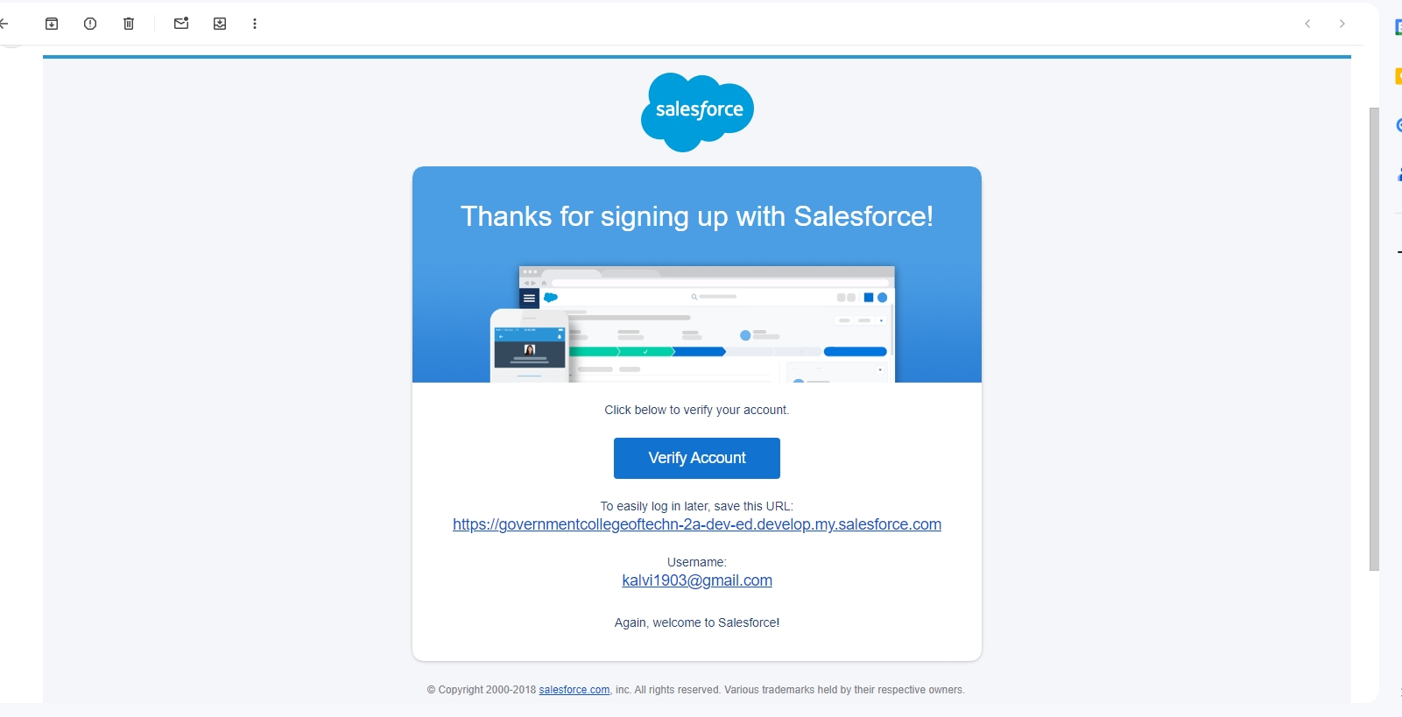
Milestone 1 - Salesforce Developer Account Creation
Purpose: Gain access to Salesforce features for application development.
Steps:
Navigate to Salesforce Developer Signup.
Fill in required details (name, email, company).
Verify your email and set up login credentials.
Access the Salesforce setup page, explore features, and start the development process.
Importance: Establishes the foundation for using Salesforce as the project platform.

Slide 8
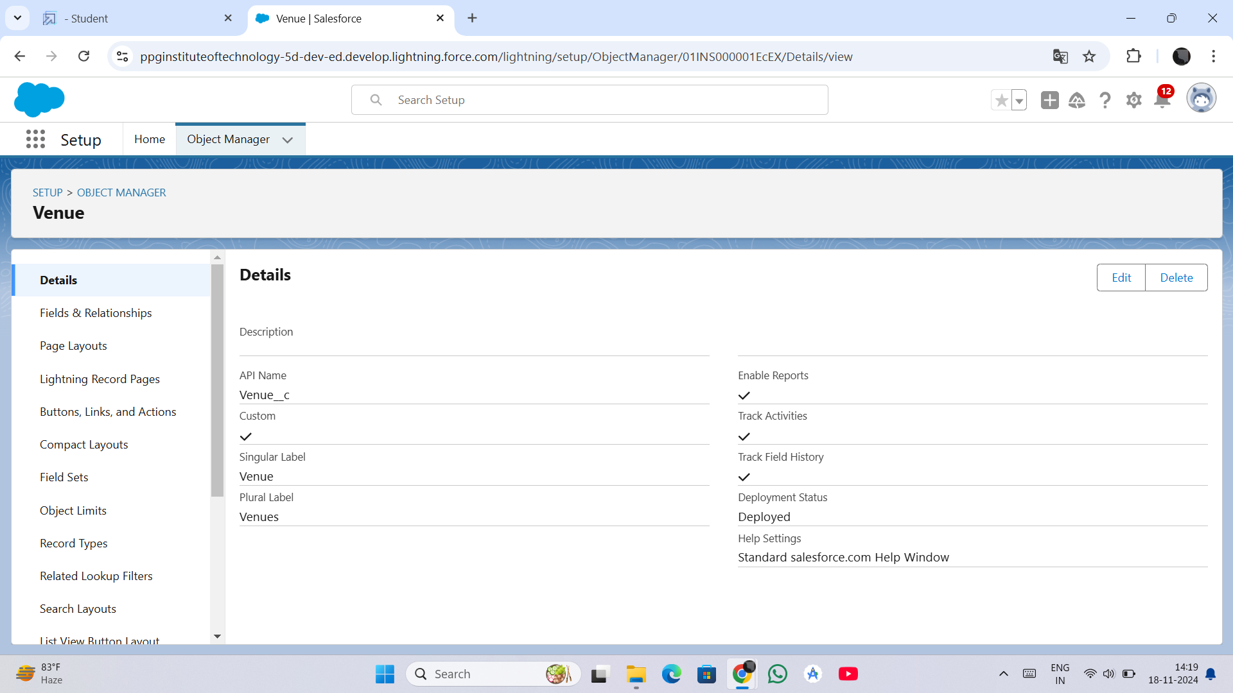
Milestone 2 - Object Creation
Purpose: Define and manage the data structure required for the application.
Custom Objects:
Venue: Tracks food donors and their location.
Drop-Off Point: Represents distribution points for food delivery.
Task: Manages activities like food pickup and delivery.
Volunteer: Tracks individuals participating in the project.
Execution Detail: Tracks the progress of activities and ensures accountability.

Slide 9
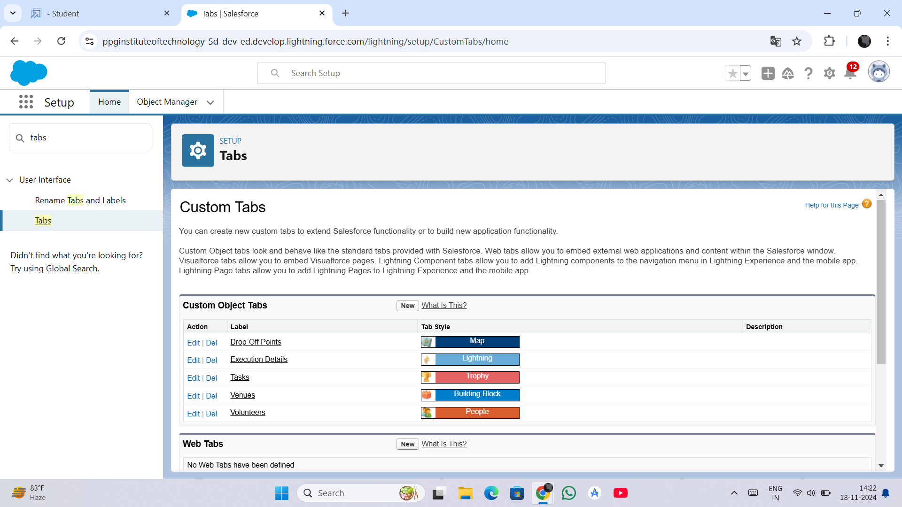
Milestone 3 - Tab Creation
Purpose: Enhance user accessibility by creating dedicated tabs for each object.
Tabs Created:
Venue Tab: Central location for all donor details.
Drop-Off Point Tab: Displays distribution point information.
Task Tab: Simplifies task management for users.
Volunteer Tab: Provides a quick overview of volunteer data.
Execution Detail Tab: Monitors the execution of activities.
Outcome: Simplifies navigation and ensures ease of use.

Slide 10
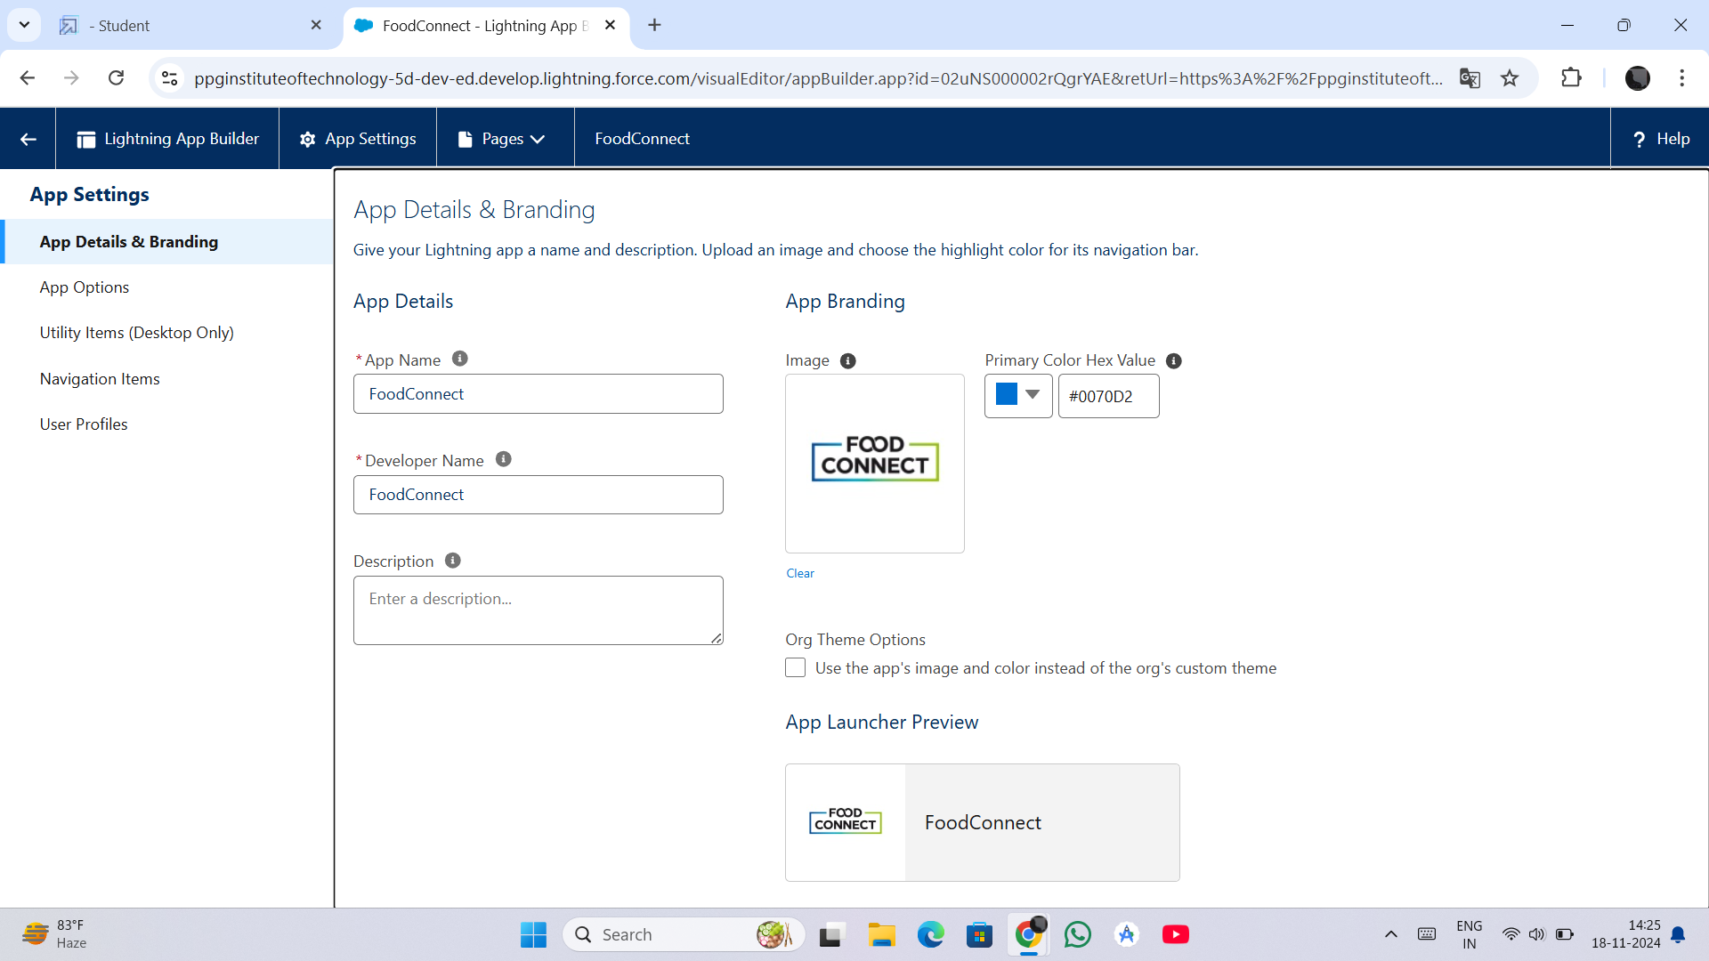
Milestone 4 - Lightning App Creation
Purpose: Build an intuitive user interface to manage project workflows.
Steps:
Navigate to App Manager in Salesforce Setup.
Click on 'New Lightning App' and fill in details like App Name and Description.
Add components (tabs, charts, reports) to enhance functionality.
Save and activate the app for user access.
Significance: Ensures smooth operation by consolidating critical tools into a single interface.

Slide 11
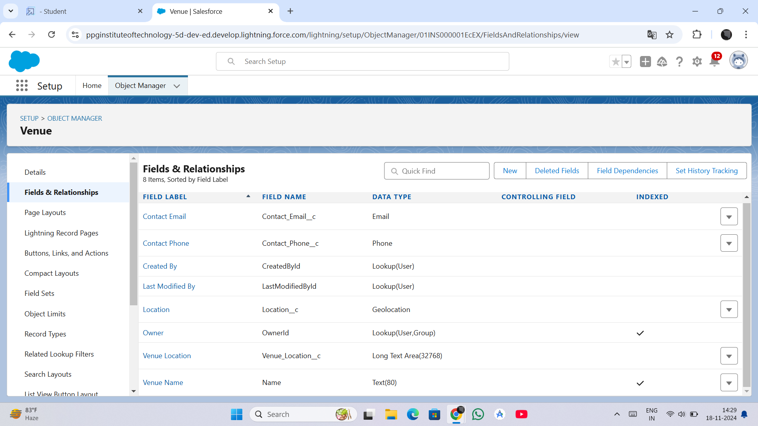
Milestone 5 - Field Relationships
Purpose: Link data across objects for seamless interaction and better management.
Key Relationships:
Master-Detail:
Example: Volunteers linked to Drop-Off Points for task assignments.
Lookup:
Example: Venues linked to Execution Details to monitor progress.
Outcome: Enables integrated workflows and better data visualization.

Slide 12
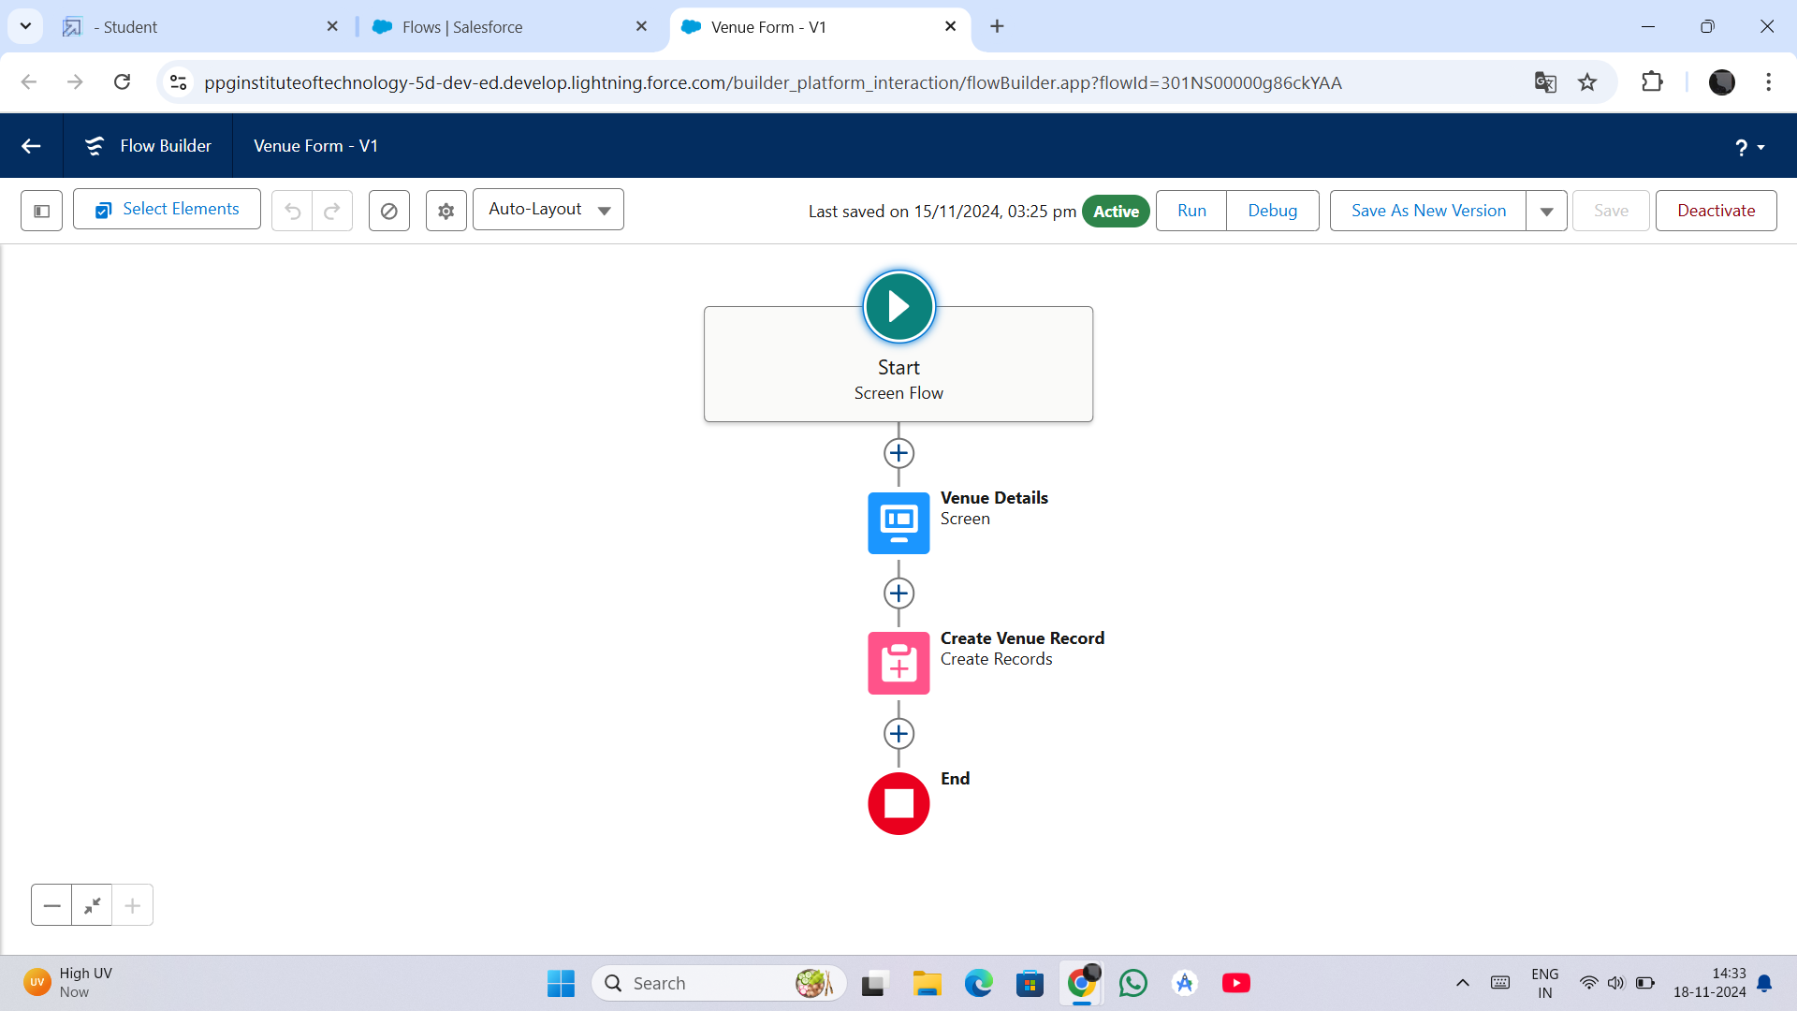
Milestone 6 - Flows
Purpose: Automate repetitive processes for efficiency.
Example: Automating Venue record creation.
Steps:
Navigate to Flow Builder and select Screen Flow.
Design the user input form with fields for Venue details.
Map user inputs to the Venue object and create records.
Save, activate, and integrate the flow into the app.
Benefits: Streamlines data entry and reduces errors.

Slide 13
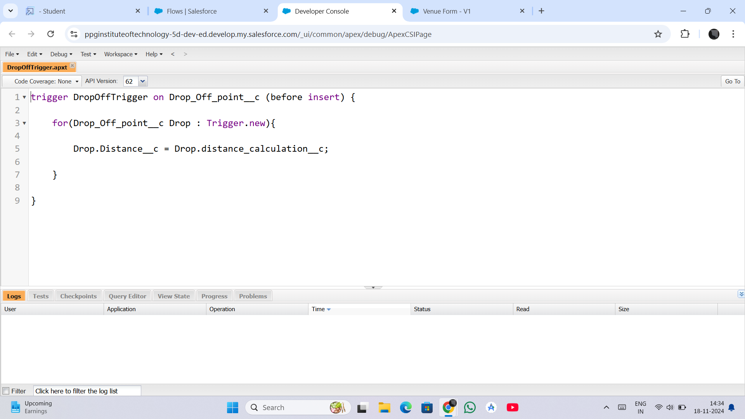
Milestone 7 - Trigger Creation
Purpose: Automate data updates and enforce business logic.
Example Code:
trigger DropOffTrigger on Drop_Off_point__c (before insert) {
for(Drop_Off_point__c Drop : Trigger.new){
Drop.Distance__c = Drop.distance_calculation__c;
}
}
Functionality: Automatically assigns calculated distances for sharing rules.
Outcome: Saves time and reduces manual interventions.

Slide 14
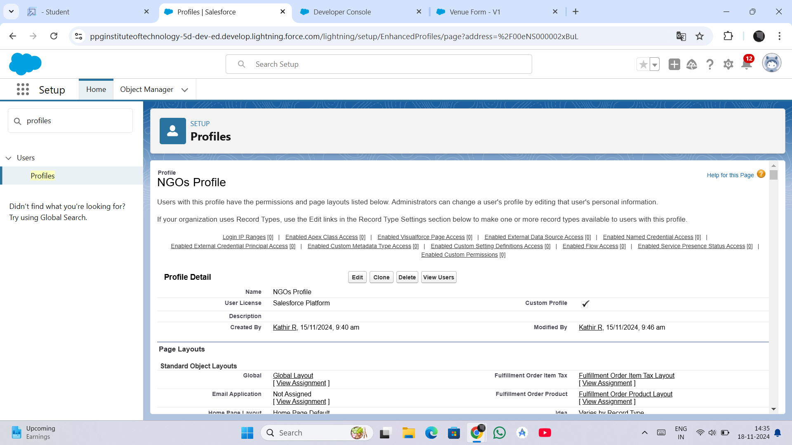
Milestone 8 - Profiles
Purpose: Define access levels and permissions for different user roles.
Profiles Created:
NGO Managers: Full access to manage operations.
Donor Managers: Access to donor-related data.
Volunteer Managers: View and manage volunteer tasks.
Significance: Ensures secure and role-based data access.

Slide 15
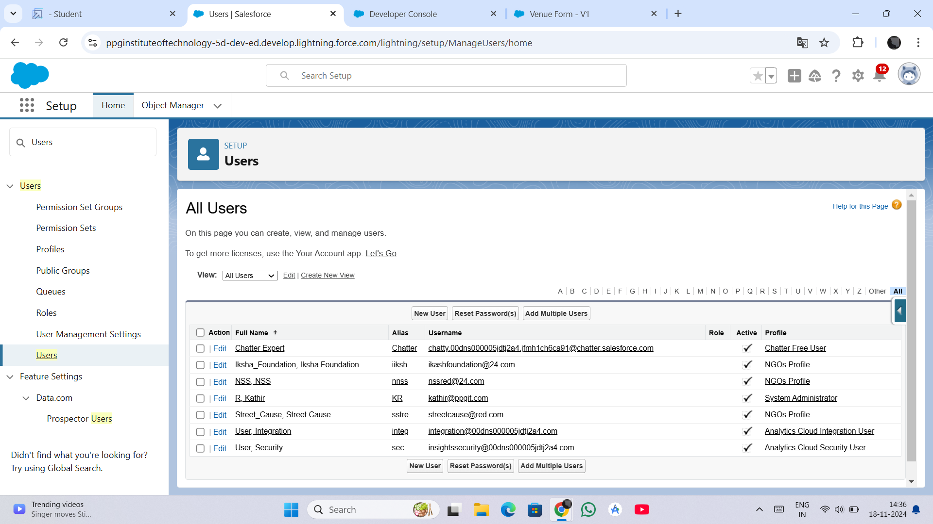
Milestone 9 - User Creation
Purpose: Enable role-specific access for users in the system.
Steps:
Navigate to Users in Salesforce Setup.
Create new users and assign appropriate profiles.
Customize permissions based on organizational roles.
Outcome: Facilitates structured collaboration.

Slide 16
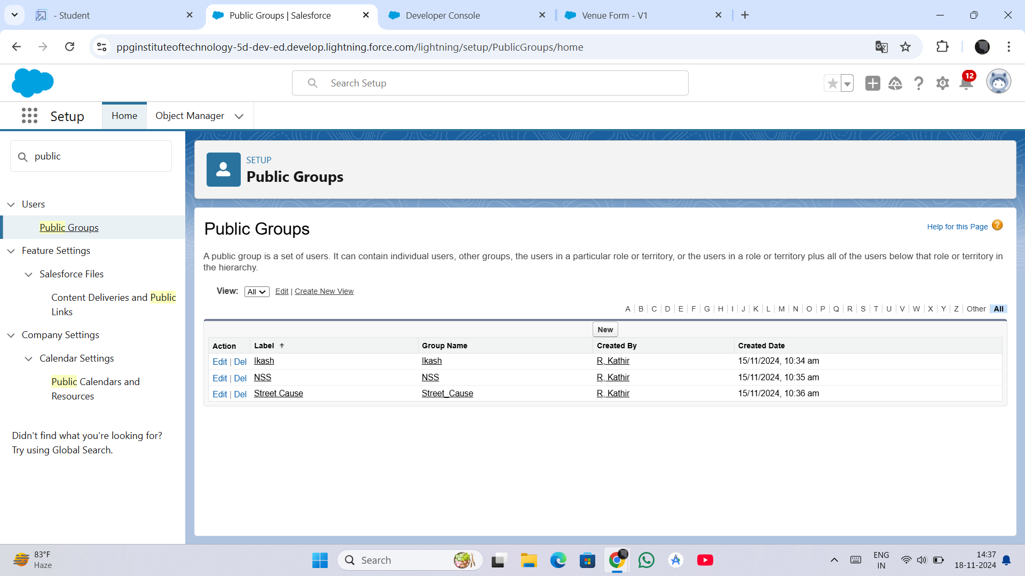
Milestone 10 - Public Groups
Purpose: Organize users into groups for efficient task management.
Groups Created:
NGO Managers: Oversee overall project operations.
Volunteers: Coordinate and execute tasks.
Significance: Simplifies collaboration and access control.

Slide 17
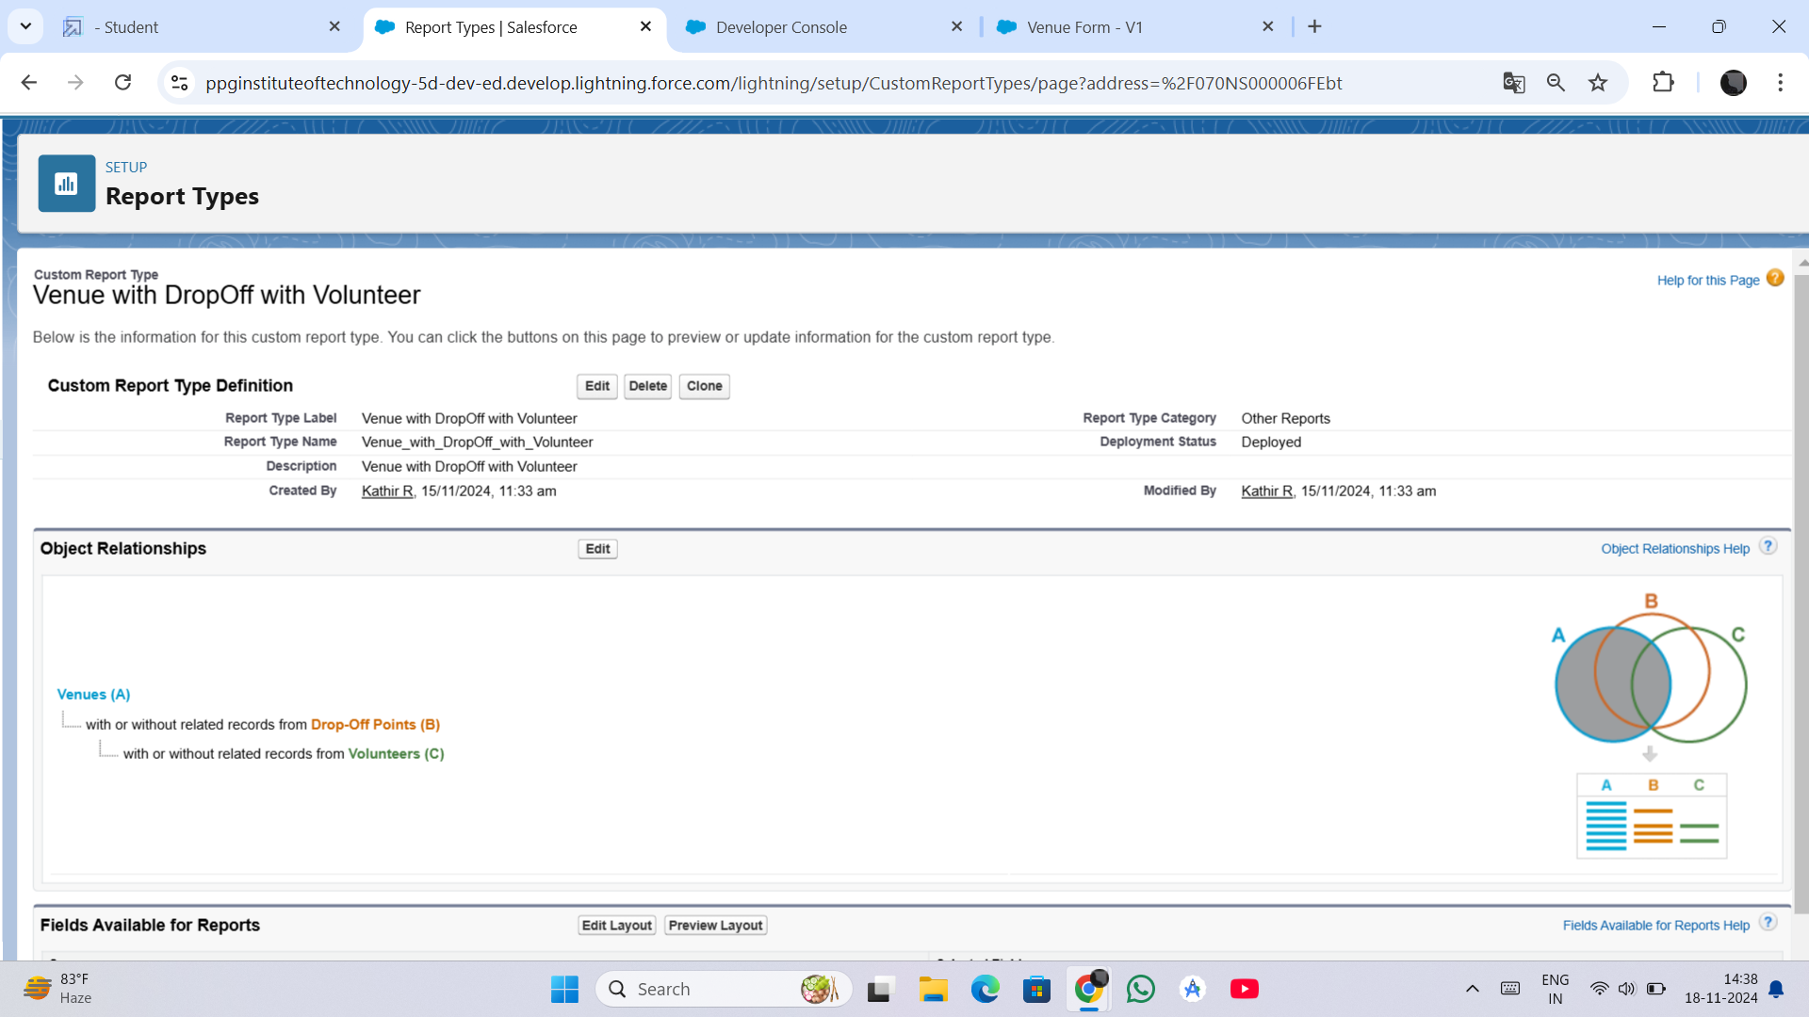
Milestone 11 - Report Types
Purpose: Define structures for generating insightful reports.
Examples:
Venue and Drop-Off Points.
Volunteers with Execution Details.
Significance: Enables meaningful analysis and decision-making.

Slide 18
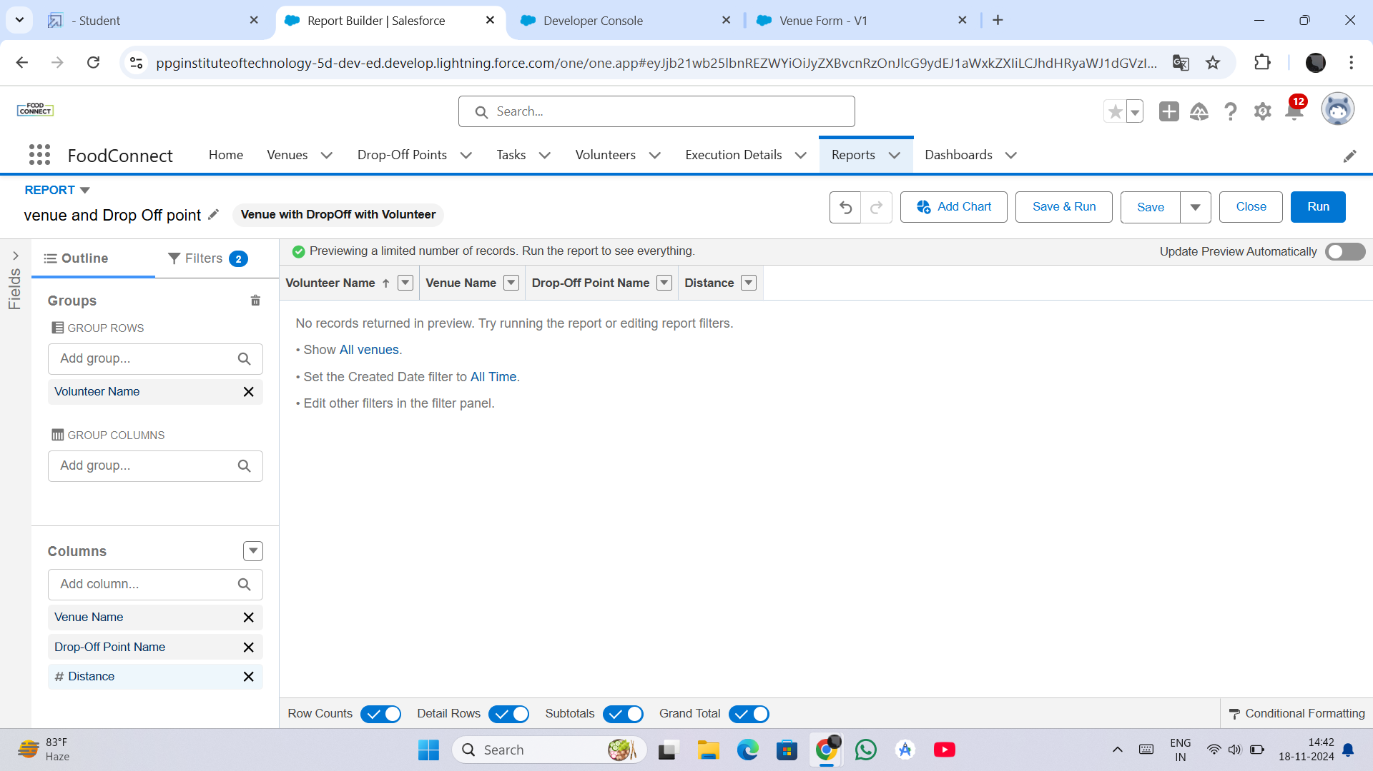
Milestone 12 - Reports
Purpose: Provide data visualization and track project metrics.
Examples:
Venue and Drop-Off Points: Tracks food collection and delivery.
Volunteers and Tasks: Monitors volunteer performance.
Outcome: Offers actionable insights for stakeholders.

Slide 19
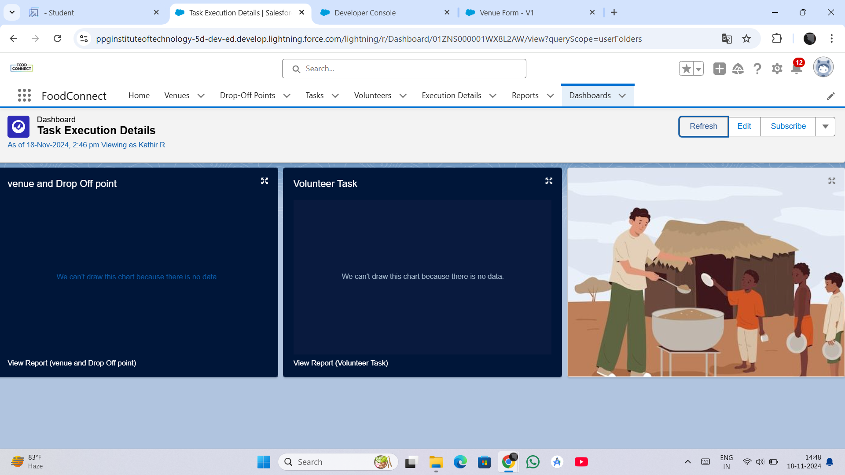
Milestone 13 - Dashboards
Purpose: Present key metrics visually for better comprehension.
Components:
Charts for task completion rates.
Tables for volunteer participation.
Significance: Helps in tracking project performance in real-time.

Slide 20
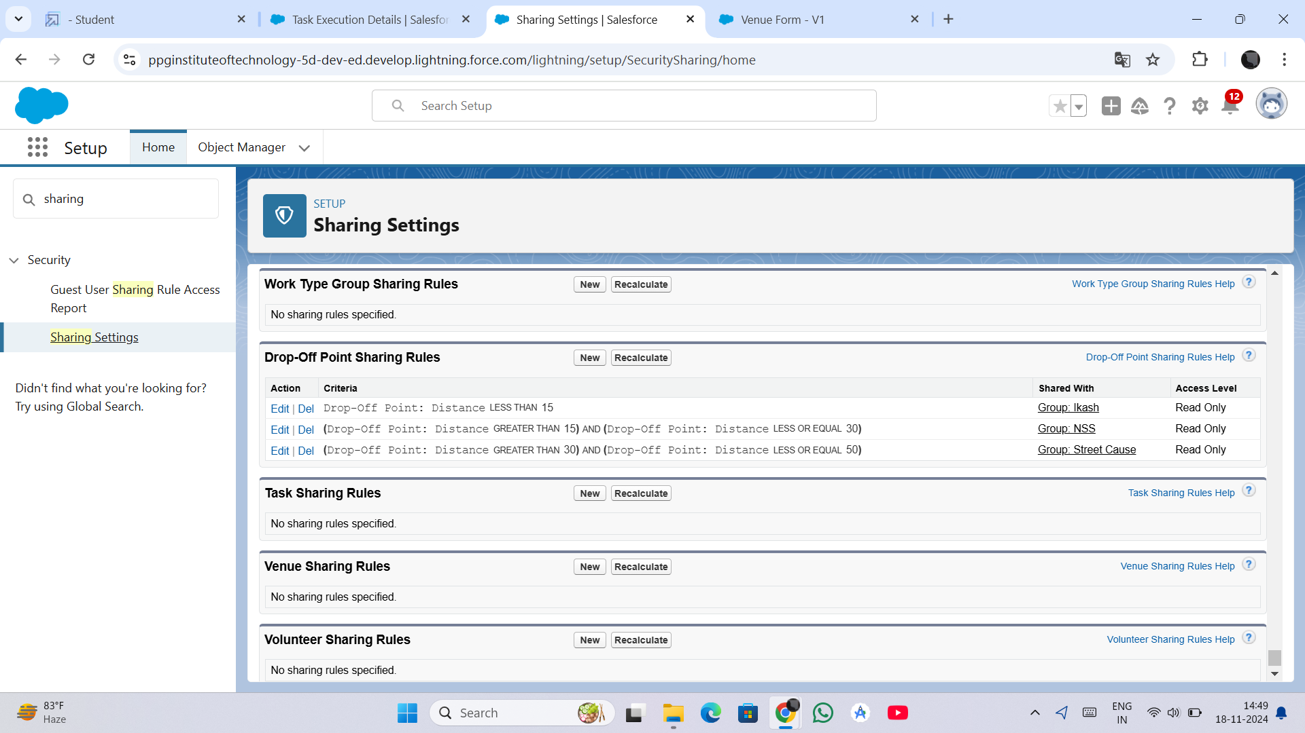
Milestone 14 - Sharing Rules
Purpose: Control data visibility based on roles and criteria.
Examples:
Rule 1: Distance < 15 km shared with Group Iksha.
Rule 2: Distance 15-30 km shared with NSS.
Outcome: Ensures data is accessible to relevant users only.

Slide 21
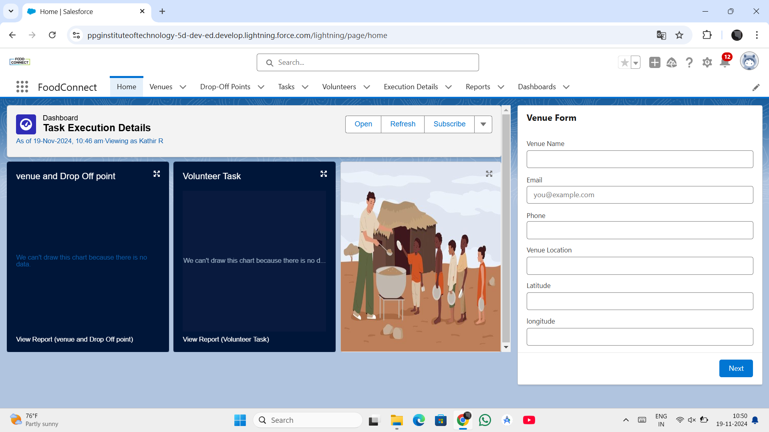
Milestone 15 - Home Page
Purpose: Customize the home page to display relevant data.
Components:
Reports (e.g., Volunteer Tasks).
News Updates.
Recent Records (e.g., Venue Details).
Significance: Enhances user efficiency by showing critical data upfront.

Slide 22
Milestone 16 - Conclusion
Achievements:
Streamlined surplus food donation process.
Improved coordination and transparency.
Impact:
Leveraged Salesforce to create a robust and efficient system.
The platform’s real-time tracking capabilities enhanced accountability and made it easier to monitor the project’s progress.
Next Steps: Expand features, improve scalability, and gather user feedback.

Slide 23
THANK YOU!

